Slide 1
UK BANK Dashboard
360° view of performance of the BANK CUSTOMERS
https://www.tableau.com/learn/training

Slide 2
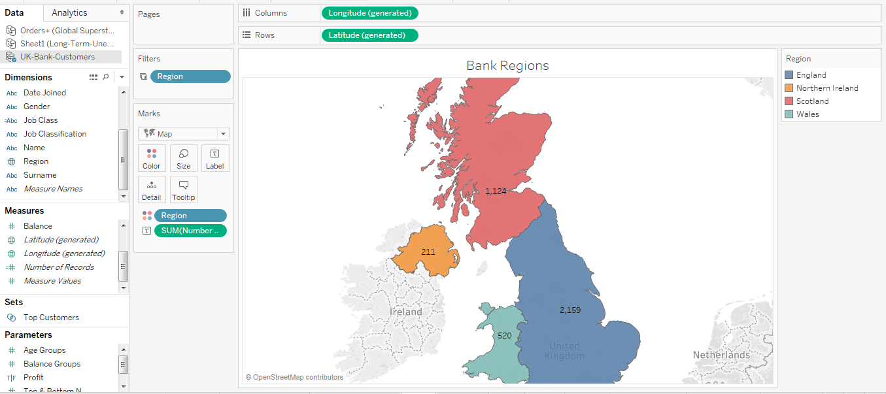
CUSTOMER COUNT BY REGION

Slide 3
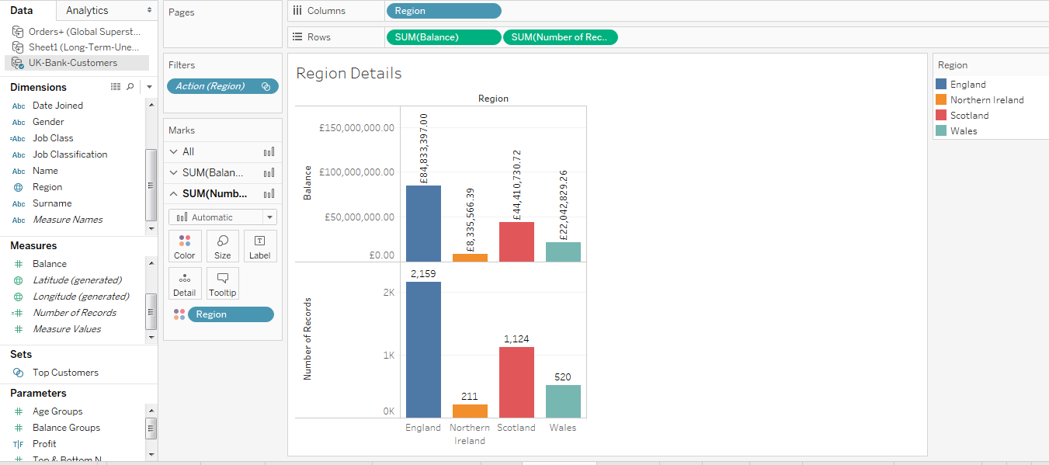
CUSTOMER COUNT AND BALANCE BY REGION

Slide 4
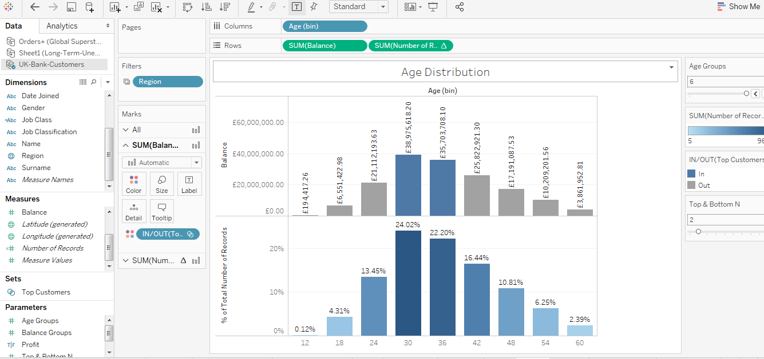
CUSTOMER COUNT AND BALANCE BY AGE BUCKET

Slide 5
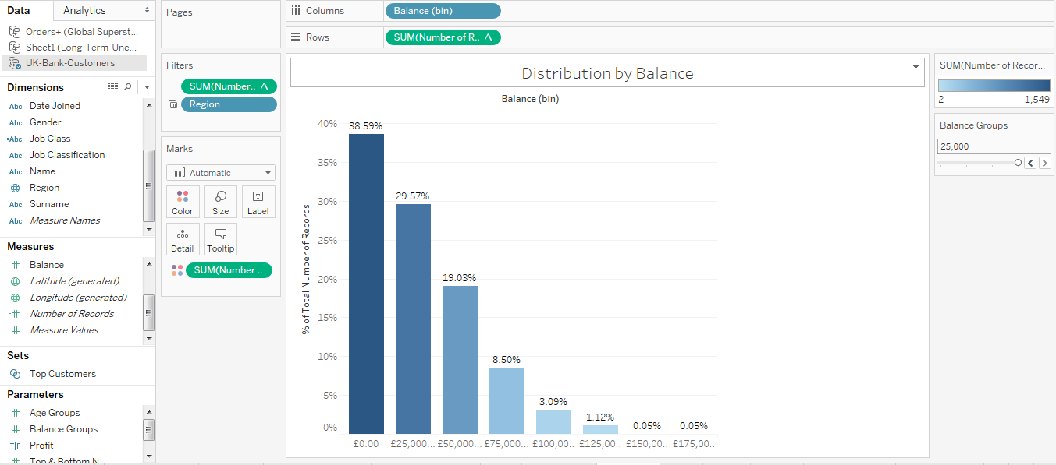
CUSTOMER DISTRIBUTION BY BANK BALANCE

Slide 6
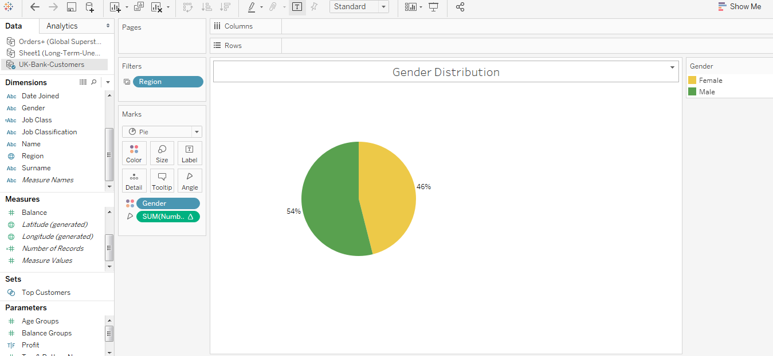
CUSTOMER DISTRIBUTION BY GENDER

Slide 7
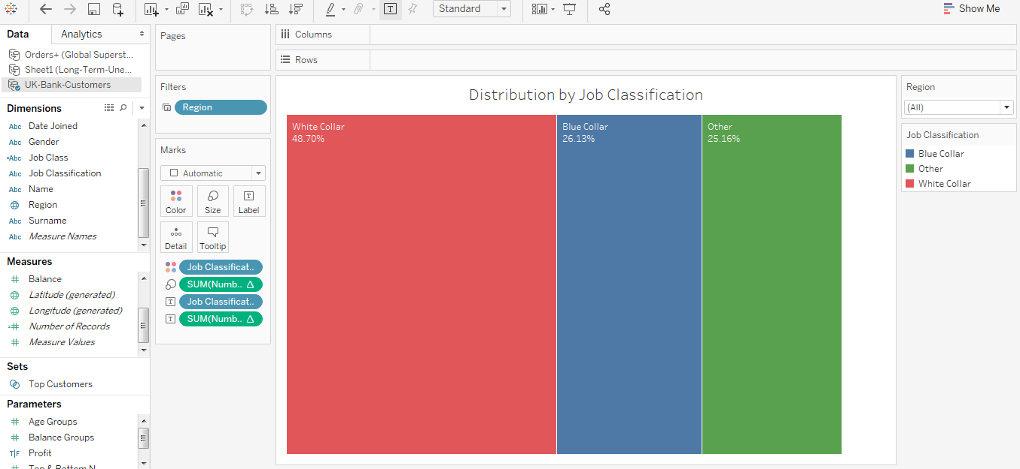
CUSTOMER DISTRIBUTION BY JOB CLASS

Slide 8
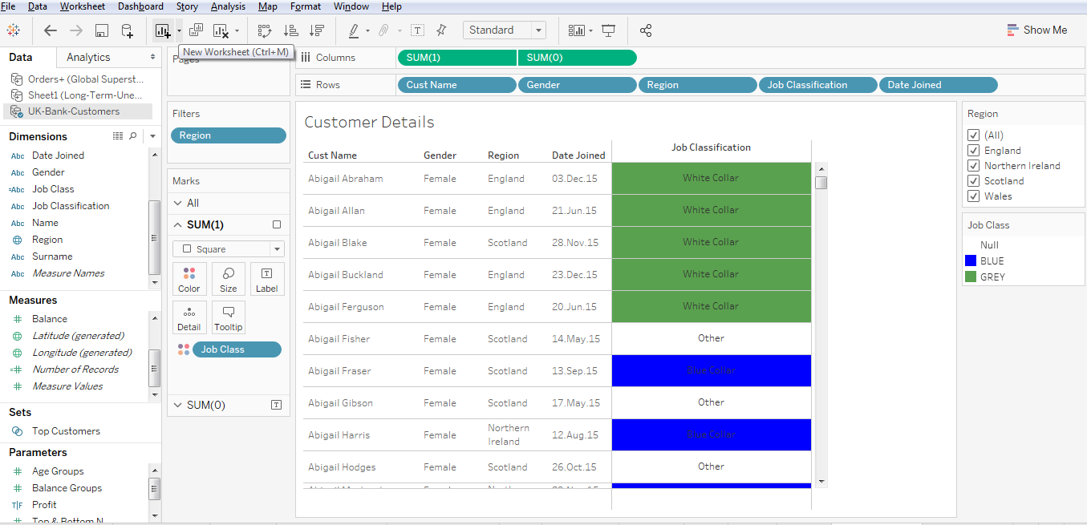
CUSTOMER DETAILS

Slide 9
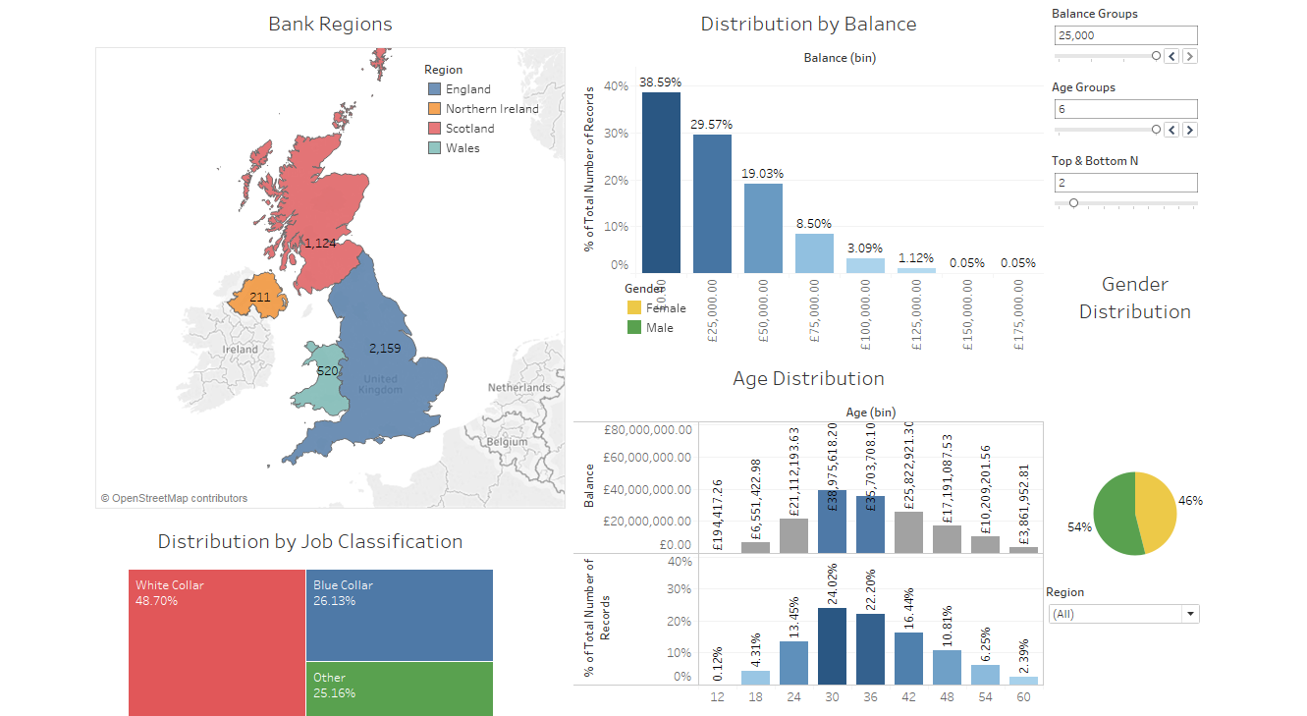
UK BANK CUSTOMERS 360°

